Slide 1
Cache Tier in Ceph
Youxu Chen

Slide 2
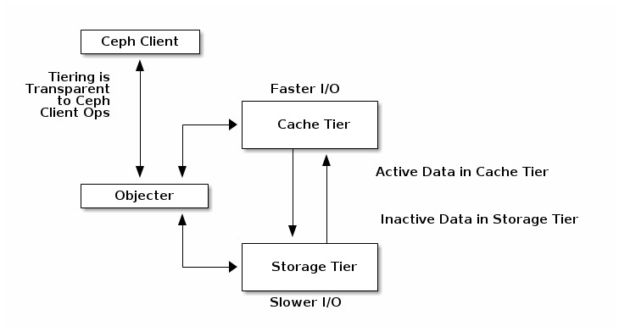
What is cache tier?
Active/inactive data decoupling to provide better I/O performance
Client-transparent caching
Cache tier
  Cache pool
  SSD or faster devices
Storage tier
  Storage pool
  usually HDD
Cache agent
Source:http://docs.ceph.com/docs/master/rados/operations/cache-tiering/

Slide 3
Cache mode
Writeback(default)
  Clients write to cache tier and receive an ACK from cache tier
  Read from cache tier first if cache hits, else read from storage tier to cache tier and resides then send to clients
Readproxy
  Read requests send to cache tier, cache tier read from storage tier and bot caching
  Write requests benefit writeback mode
Forward
  All requests redirect to storage tier
Readonly
  Write to storage tier directly and read from cache tier if cache hits, else read from storage tier and resides then send to clients
Readforward
  Read requests redirect to storage tier and write requests benefit writeback mode

Slide 4
Cache tier deployment
Creating a cache tier
  Add a hot-storage pool to a cold-storage pool
    ceph osd tier add cold-storage hot-storage
  Set cache mode of hot-storage pool
    ceph osd tier cache-mode hot-storage writeback
  Direct all client traffic from the storage pool to the cache pool
    ceph osd tier set-overlay cold-storage hot-storage
Configuring a cache tier
  ceph osd pool set {cachepool} {key} {value}
  Detailed keys please search from the above hyper-link
Removing a cache tier
  please search from the above hyper-link

